Slide 1
Lecture 15: Convolutional Neural Network (Part 3)
Instructor: Yang Xu
Slides inspired by the deeplearning.ai series courses on Coursera.org

Slide 2
Outlines
Review: Softmax layer
Classic networks
LeNet-5
AlexNet
VGG
ResNet
Why convolution
Implementation
Backprop of ConvNet
ML frameworks

Slide 3
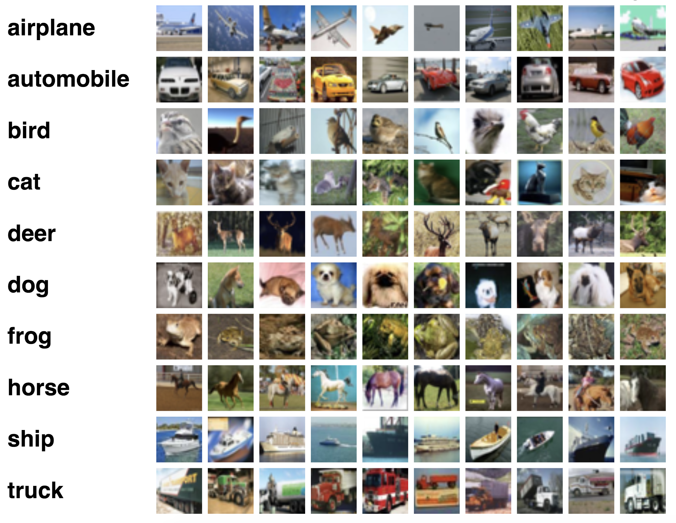
Review: softmax layer
Softmax regression: for multi-class classification problems
E.g., CIFAR-10 datasets: 60,000 images in 10 classes,
Labels:
Airplane = 0
Automobile = 1
Bird = 2
Cat = 3
Deer = 4
Dog = 5
Frog = 6
Horse = 7
Ship = 8
Truck = 9

Slide 4
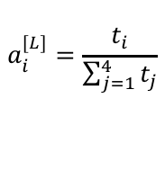
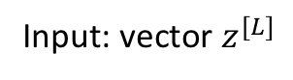
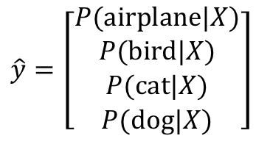
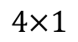
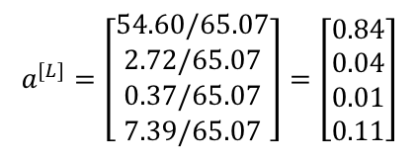
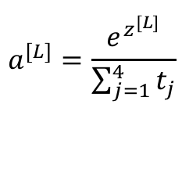
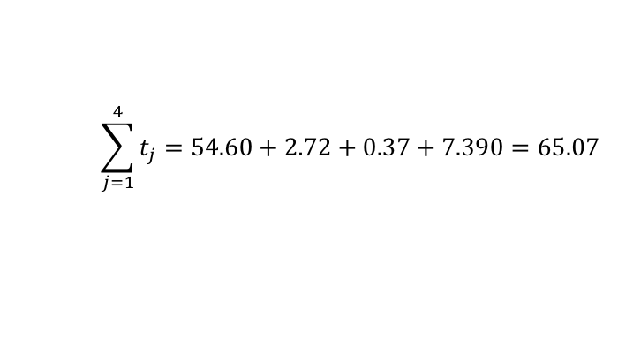
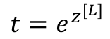
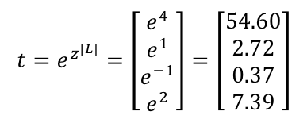
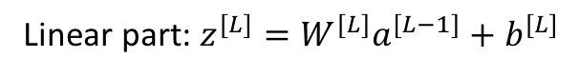
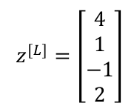
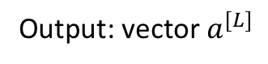
Softmax layer
Size of output layer = number of classes = 4 (airplane, bird, cat, dog)
4 units in output layer
$$z^{[L]}=\left[\begin{aligned}4 \\ 1 \\ −1 \\ 2\end{aligned}\right]$$
$$t=e^{z^{[L]}}=\left[\begin{aligned}e^{4} \\ e^{1} \\ e^{−1} \\ e^{2}\end{aligned}\right]=\left[\begin{aligned}54.60 \\ 2.72 \\ 0.37 \\ 7.39\end{aligned}\right]$$
$$\hat{y}=\left[\begin{aligned}P(\text{airplane}|X) \\ P(\text{bird}|X) \\ P(\text{cat}|X) \\ P(\text{dog}|X)\end{aligned}\right]$$
X
…
$$\sum_{j=1}^{4}{t_{j}}=54.60+2.72+0.37+7.390=65.07$$
Linear part: $z^{[L]}=W^{[L]}a^{[L−1]}+b^{[L]}$
$$a^{[L]}=\left[\begin{aligned}54.60/65.07 \\ 2.72/65.07 \\ 0.37/65.07 \\ 7.39/65.07\end{aligned}\right]=\left[\begin{aligned}0.84 \\ 0.04 \\ 0.01 \\ 0.11\end{aligned}\right]$$
$$4×1$$
Activation part:
$$t=e^{z^{[L]}}$$
$$4×1$$
Softmax activation
function
$$a^{[L]}=\frac{e^{z^{[L]}}}{\sum_{j=1}^{4}{t_{j}}}$$
P(airplane|X) = 0.84
P(bird|X) = 0.04
P(cat|X) = 0.01
P(dog|X) = 0.11
$$4×1$$
Input: vector $z^{[L]}$
Output: vector $a^{[L]}$
$$a_{i}^{[L]}=\frac{t_{i}}{\sum_{j=1}^{4}{t_{j}}}$$
In which,

Slide 5
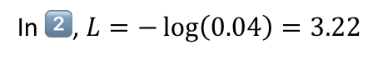
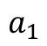
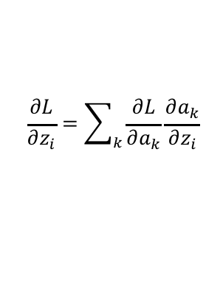
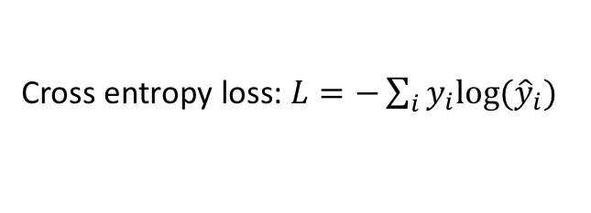
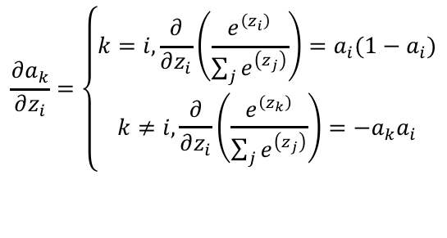

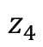
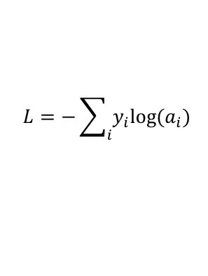
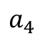
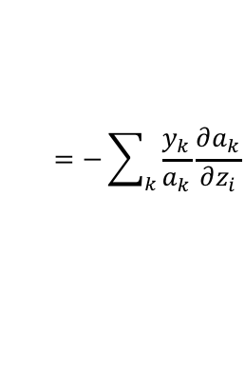
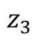
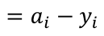
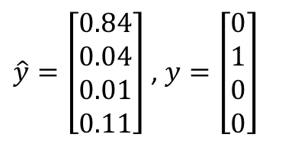
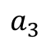
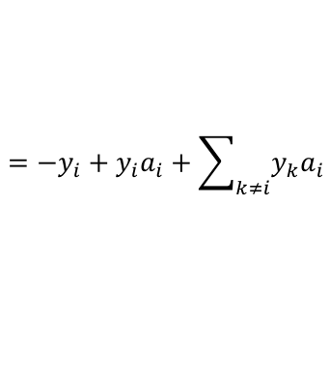
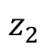
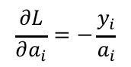
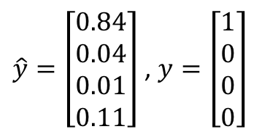
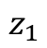
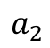
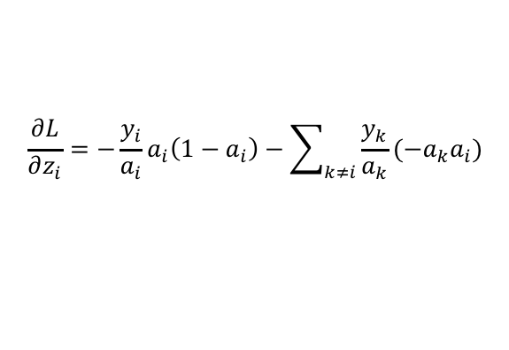
Softmax layer: loss function
$\hat{y}=\left[\begin{aligned}0.84 \\ 0.04 \\ 0.01 \\ 0.11\end{aligned}\right]$ , $y=\left[\begin{aligned}1 \\ 0 \\ 0 \\ 0\end{aligned}\right]$
Cross entropy loss: $L=−\sum_{i}{y_{i}log⁡({\hat{y}}_{i})}$
1️⃣
😊
Measures the distance between output distribution ($\hat{y}$) and the actual distribution ($y$)
$\hat{y}=\left[\begin{aligned}0.84 \\ 0.04 \\ 0.01 \\ 0.11\end{aligned}\right]$ , $y=\left[\begin{aligned}0 \\ 1 \\ 0 \\ 0\end{aligned}\right]$
In 1️⃣, $L=−\log\left(0.84\right)=0.174$
2️⃣
🙁
In 2️⃣, $L=−\log\left(0.04\right)=3.22$
$$z_{1}$$
$$a_{1}$$
$$L=−\sum_{i}{y_{i}log⁡(a_{i})}$$
$$\frac{∂a_{k}}{∂z_{i}}=\left\{\begin{aligned}k=i, \frac{∂}{∂z_{i}}\left(\frac{e^{\left(z_{i}\right)}}{\sum_{j}{e^{\left(z_{j}\right)}}}\right)=a_{i}(1−a_{i}) \\ k≠i,\frac{∂}{∂z_{i}}\left(\frac{e^{\left(z_{k}\right)}}{\sum_{j}{e^{\left(z_{j}\right)}}}\right)=−a_{k}a_{i}\end{aligned}\right.$$
$$\frac{∂L}{∂z_{i}}=\sum_{k}{\frac{∂L}{∂a_{k}}\frac{∂a_{k}}{∂z_{i}}}$$
$$=−\sum_{k}{\frac{y_{k}}{a_{k}}\frac{∂a_{k}}{∂z_{i}}}$$
$$z_{2}$$
$$a_{2}$$
$$\frac{∂L}{∂a_{i}}=−\frac{y_{i}}{a_{i}}$$
$$z_{3}$$
$$a_{3}$$
$$z_{4}$$
$$a_{4}$$
$$\frac{∂L}{∂z_{i}}=−\frac{y_{i}}{a_{i}}a_{i}\left(1−a_{i}\right)−\sum_{k≠i}{\frac{y_{k}}{a_{k}}(−a_{k}a_{i})}$$
$$=−y_{i}+y_{i}a_{i}+\sum_{k≠i}{y_{k}a_{i}}$$
$$=a_{i}−y_{i}$$
Gradient in the same form as binary classification

Slide 6
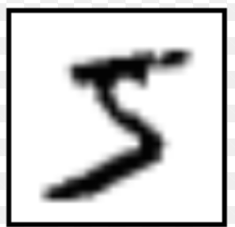
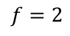
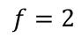
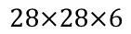
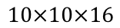
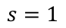
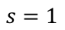
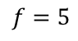
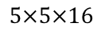
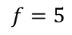
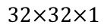
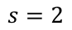
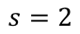
LeNet-5
LeCun et al., 1998, Gradient-based learning applied to document recognition
Avg pool
Avg pool
$$f=5$$
$$f=2$$
$$f=5$$
$$f=2$$
$$s=1$$
$$s=2$$
$$s=1$$
$$s=2$$
Softmax
$$10×10×16$$
$$5×5×16$$
84
$$32×32×1$$
$$28×28×6$$
120
Number of parameters: 60k
In the original paper:
sigmoid and tanh are used for activation
Had non-linear activation after pooling

Slide 7
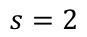
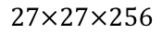
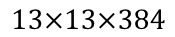
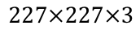

















AlexNet
Krizhevsky, 2012, Imagenet classification with deep convolutional neural networks
“same” conv
Max pool
Max pool
“same” conv
$$f=3$$
$$f=11$$
$$f=3$$
$$p=1$$
$$f=3$$
$$s=4$$
$$s=2$$
$$s=1$$
$$s=2$$
$$f=3$$
$$55×55×96$$
$$27×27×96$$
$$27×27×256$$
$$13×13×256$$
$$13×13×384$$
$$227×227×3$$
# parameters: 60 million
“same” conv
“same” conv
Max pool
ReLU activation
$$f=3$$
$$f=3$$
$$f=3$$
$$s=2$$
Softmax
100
$$13×13×384$$
$$13×13×256$$
$$6×6×256$$
9216
4096
4096

Slide 8
Does AlexNet overfit?
Data augmentation
Mirror, random crops
Increase training data by a factor of 2048
Dropout
Dorp prob = 0.5
Applied to FC layers

Slide 9
















VGG-16
Simonyan & Zisserman, 2014, Very deep convolutional networks for large-scale image recognition
Using more uniform layers: Conv → $f=3$, $p=2$, $s=1$ (“same” conv); Pool → $f=2$, $s=2$, max pooing
(Conv 64)
$$×2$$
(Conv 128)
$$×2$$
Pool
Pool
$$224×224×64$$
$$112×112×64$$
$$112×112×128$$
$$56×56×128$$
$$224×224×3$$
VGG-“16”: 16 layers that have weights
(Conv 256)
$$×3$$
(Conv 512)
$$×3$$
# of parameters: 138 m
Pool
Pool
$$56×56×256$$
$$28×28×256$$
$$28×28×512$$
$$14×14×512$$
(Conv 512)
$$×3$$
Pool
Softmax
1000
$$14×14×512$$
$$7×7×512$$
FC 4096
FC 4096
=25088

Slide 10
ResNet
He et al., 2016, Deep residual learning for image recognition
Very very deep neural networks are difficult to train
Due to vanishing and exploding gradients
Skip-connection
Feed the activation from one layer to another layer that is much deeper

Slide 11














Residual block (why called so?)
$$a^{[l+1]}$$
Types of short cuts:
Identify
Projection
zero padding
matrix multiplication: $W_{s}x$
$$a^{[l]}$$
$$a^{[l+2]}$$
Skip connection (short cut)
$$a^{[l+2]}=g(z^{\left[l+2\right]}+a^{[l]})$$
$$a^{[l+1]}=g(z^{[l+1]})$$
$$a^{[l+2]}=g(z^{[l+2]})$$
$$a^{[l]}$$
$$z^{[l+1]}$$
$$a^{[l+1]}$$
$$z^{[l+2]}$$
$$a^{[l+2]}$$
Linear
ReLU
Linear
ReLU
$$z^{[l+1]}=W^{[l]}a^{[l]}+b^{[l]}$$
$$z^{[l+2]}=W^{[l+1]}a^{[l+1]}+b^{[l+1]}$$
Using this residual block allows for training much deeper neural networks

Slide 12




Residual network
ResNet
$$x$$
$$a^{[l]}$$
“Plain” deep neural network
$$x$$
$$a^{[l]}$$

Slide 13


Residual network
Problem with “plain” network: degradation
ResNet does not have such issue

Slide 14




Why ResNet works?
$$x$$
DNN
$$a^{[l]}=g(a^{[l]})$$
$$a^{[l]}$$
$$x$$
DNN
$$a^{[l+2]}=g(z^{[l+2]}+a^{[l]})$$
Adding additional layers with the hope to increase performance
Also brings the risk of degradation
The “short cut” makes it easy to learn a shallower network if the deeper one does not work well
“Plan B”: makes sure that it does not hurt performance, and maybe help with performance

Slide 15


ResNet on images
ResNet
Plain ConvNet
VGG-19

Slide 16

ResNet: where does the name come from?
Output H(x) = F(x) + x
F(x) = H(x) - x

Slide 17


Performance comparison of classical ConNets
ImageNet (1000 classes)
CIFAR-10 (10 classes)

Slide 18
Why does convolution work?
Parameter sharing
Filter scanning the input
A feature detector useful in one place is probably useful in another place
Sparsity of connections
Not fully connected
Translational invariance
E.g., a picture of cat can still be recognized as a cat after shifting some pixels
Fewer parameters

Slide 19




Backpropagation in Conv and Pool layers
A
W
$${dZ}_{hw}$$
Z
$$dA+= \sum_{h=0}^{n_{H}}{\sum_{w=0}^{n_{W}}{W_{c}×{dZ}_{hw}}}$$
$$dW+= \sum_{h=0}^{n_{H}}{\sum_{w=0}^{n_{W}}{A_{slice}×{dZ}_{hw}}}$$
$$db+= \sum_{h=0}^{n_{H}}{\sum_{w=0}^{n_{W}}{{dZ}_{hw}}}$$

Slide 20

Implementation with ML frameworks
PyTorch implementation of AlexNet: https://github.com/pytorch/vision/blob/master/torchvision/models/alexnet.py

Slide 21
Next lecture
Recurrent Neural Network (RNN)

